Slide 1
Git Tutorial

Slide 2
Outline
Version Control Basics
Creating a Repository
Cloning a Repository
Making Changes to a Repository
Updating the Master Branch

Slide 3
Version Control Basics
Version Control
Repository for code
Saves the entire history of the code base
Allows multiple users to simultaneously update parts of the code base

Slide 4
Version Control Basics
Types of Repositories
Local: File location
Remote: URL

Slide 5
Version Control Basics
Branching
Branch - A copy of the current codebase commit, made to add changes
As many branches can be created as needed
Merged back into original code base when done
Version Control System will determine any issues with multiple changes on the same piece of code, if any

Slide 6
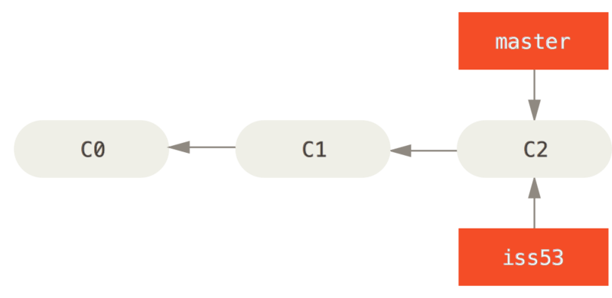
Version Control Basics
Branching

Slide 7
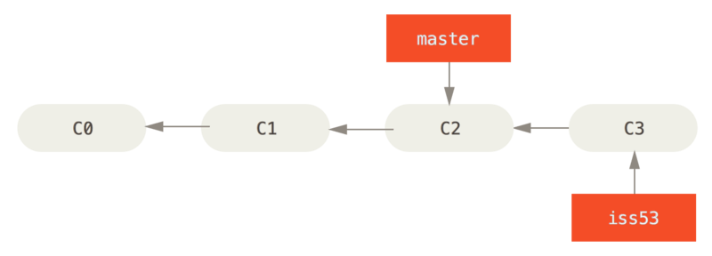
Version Control Basics
Branching

Slide 8
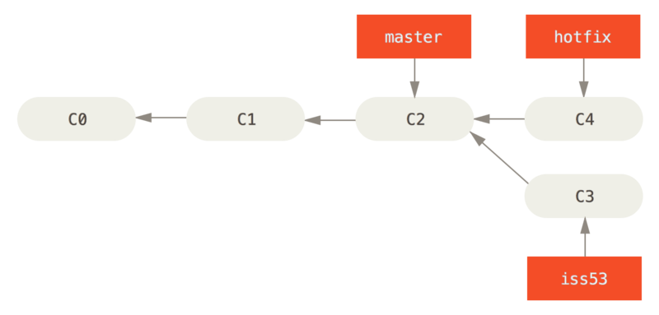
Version Control Basics
Branching

Slide 9
Version Control Basics
Version Control Types
Centralized Version Control System (CVCS)
All code is stored on a central server
Distributed Version Control System (DVCS)
A copy of the entire repository is stored on each system working with the codebase

Slide 10
Version Control Basics
Centralized Version Control System
New code is added to the CVCS
Code that needs changed is checked out
Other users cannot change at this time
Code is submitted/checked in once changes are complete
Change list is submitted with the code to describe what has changed
Code can be deleted from the repository
Any changes can be reverted to any previous submission

Slide 11
Version Control Basics
Centralized Version Control System Examples
Subversion (SVN)
PerForce
Team Foundation Server

Slide 12
Version Control Basics
Distributed Version Control System
A master branch is created, which represents the original code base
When changes needed, a copy of the master branch is made
Changes are submitted to the copy
When all changes done, the copy is merged to the master branch
Depending on permissions, someone may need to accept the merge before it takes place.

Slide 13
Version Control Basics
Distributed Version Control System Examples
Git
Github
Gitlab
Mercurial
Team Foundation Server (has distributed options)

Slide 14
Creating a Repository
Creating a Repository
A repository is created by initializing it using ‘init’
When using this keyword, the repository is the current directory as well as all subdirectories

Slide 15
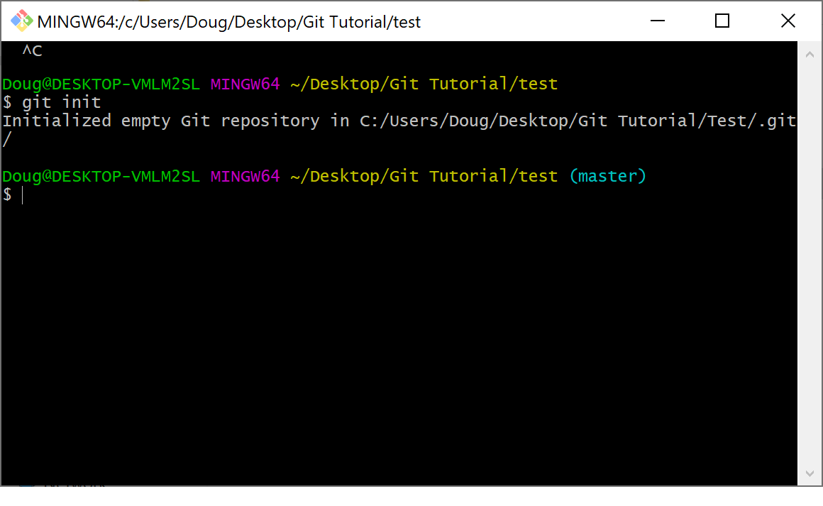
Creating a Repository

Slide 16
Creating a Repository

Slide 17
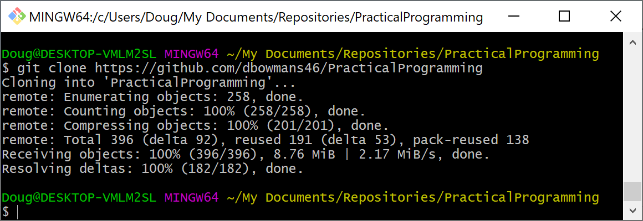
Cloning a Repository
Cloning a Repository
Making a copy of a repository
Cloning is done via ‘clone’: ‘git clone <url_of_remote_repository>’

Slide 18
Making Changes to a Repository
Making Changes a Repository – The General Process
Make changes to the file
Stage the files that contain the changes
Commit the changes to the repository

Slide 19
Making Changes to a Repository
Making Changes a Repository
The staging area is a virtual “location” that marks files that will be updated in the repository
Files are staged by using the ‘add’ keyword
‘git add –a’ will add all the files in the current repository to the staging area
‘git add –u’ will add all the updated files to the staging area
‘git add <filename>’ will add a specific file to the staging area

Slide 20
Making Changes to a Repository
Committing Changes to Repository
Changes are finalized in a repository by committing them
Commit keyword is used: ‘git commit –m ‘A message goes here that identifies the changes in the commit’

Slide 21
Making Changes to a Repository
Example: Creating and Modifying Files in a Repo
Add initial file
Make changes to file
Commit changes to file to repo

Slide 22
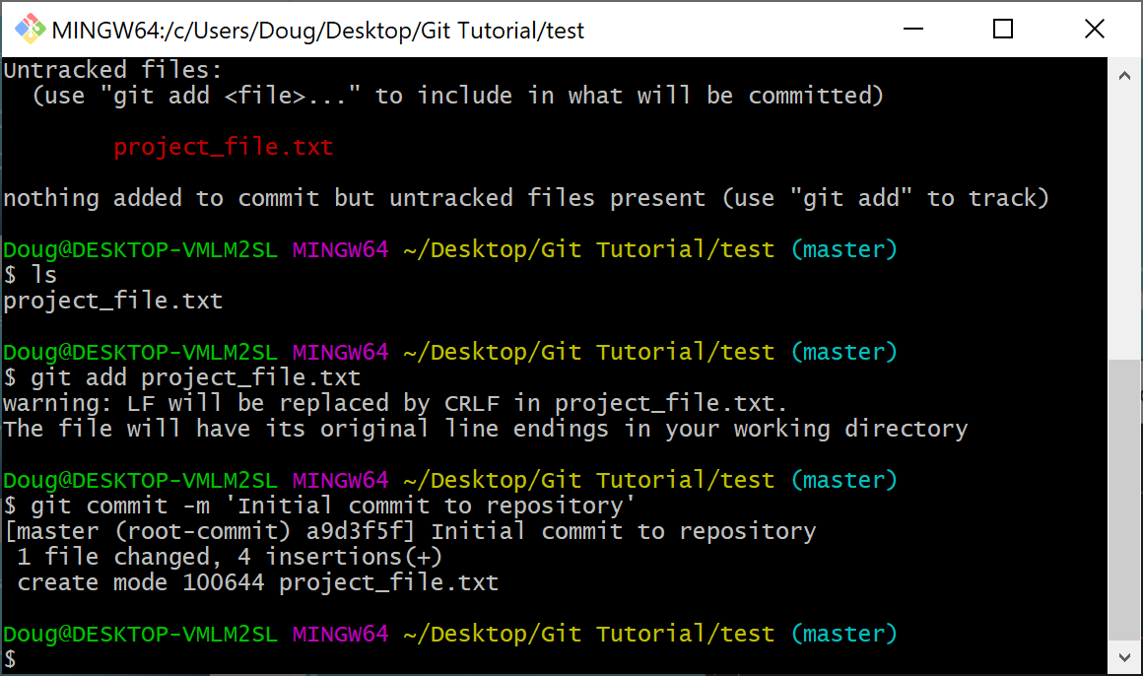
Making Changes to a Repository

Slide 23
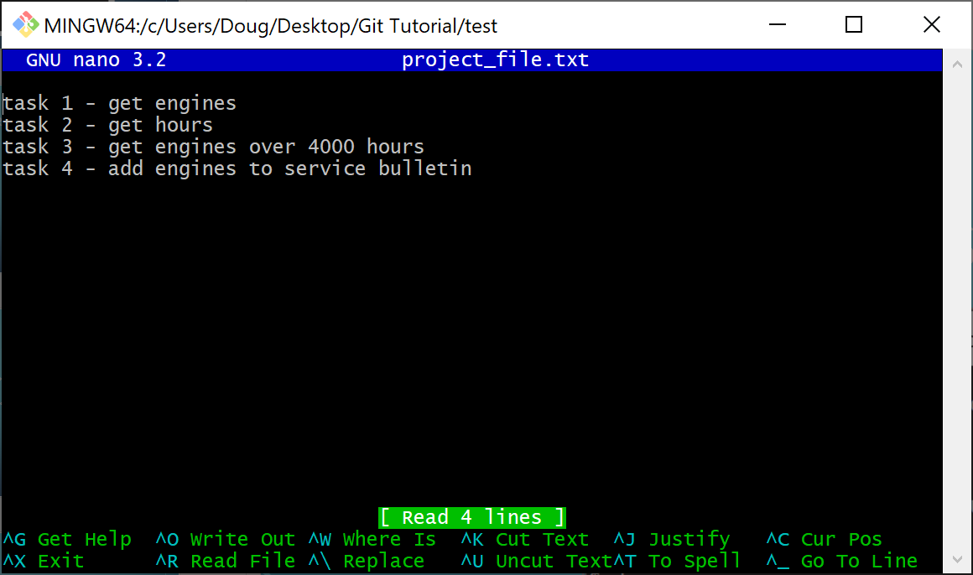
Making Changes to a Repository

Slide 24
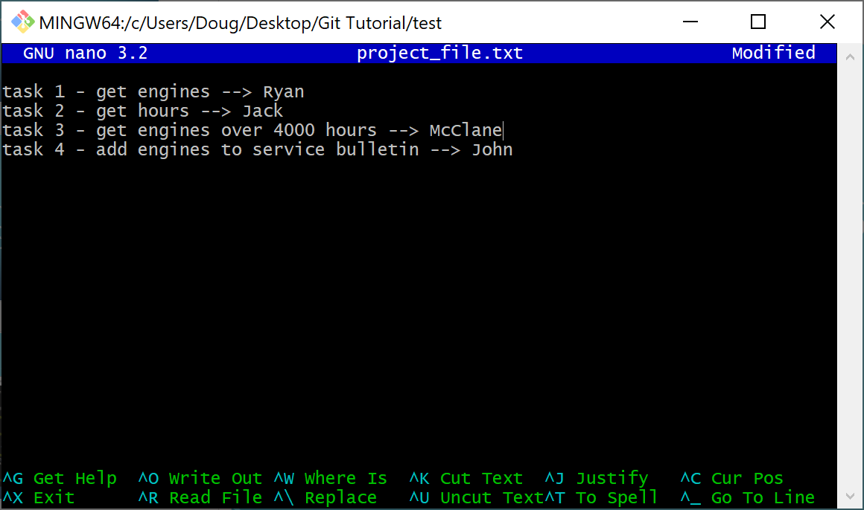
Making Changes to a Repository

Slide 25
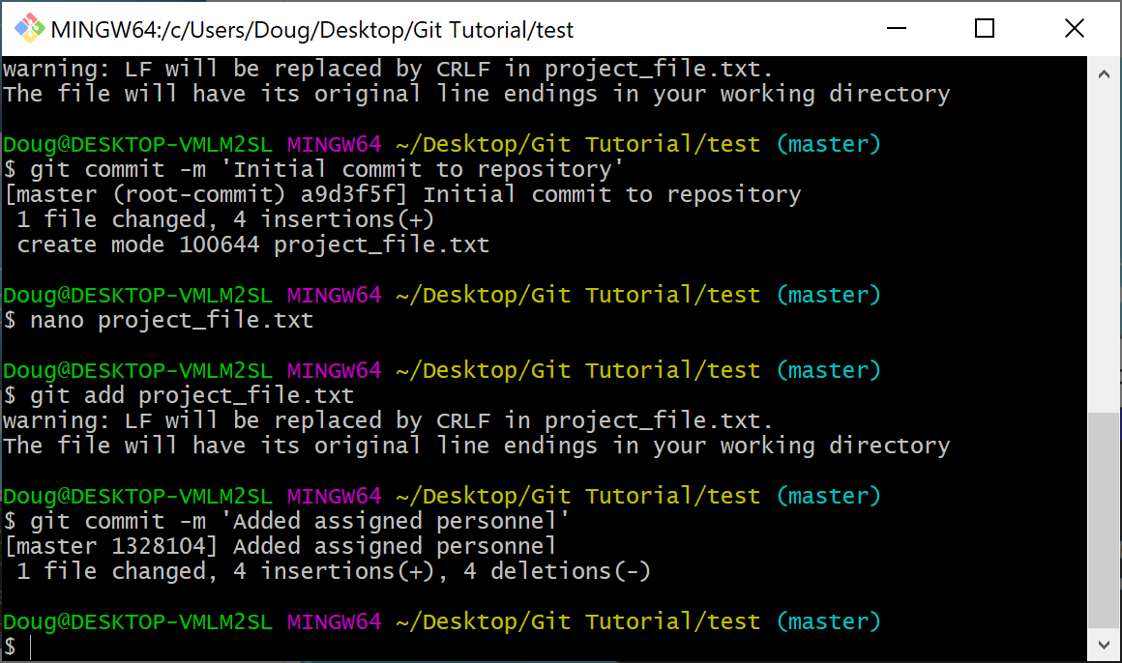
Making Changes to a Repository

Slide 26
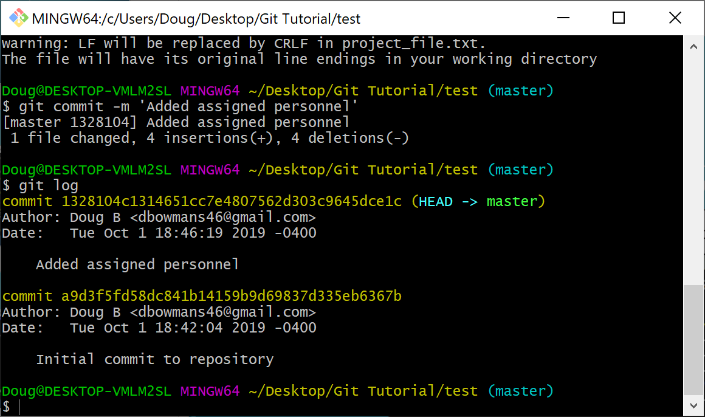
Making Changes to a Repository

Slide 27
Making Changes to a Repository
Undoing a Commit
Use the ‘reset’ keyword: ‘git reset <commit_id>’
Unstaging a File (Undoing ‘add)
‘git reset <filename>’

Slide 28
Updating the Master Branch
Merging/Pushing the repository to the master branch
Local:
switch to the branch you want to merge to
‘git merge <branch_to_merge>’
Remote Repo:
‘git push <alias> <branch_to_push_to>’

Slide 29
Updating the Master Branch
Merging Remote Branch
Add and commit files to local branch
Then push to the remote repo:
‘git push origin <branch_to_push_to>’

Slide 30
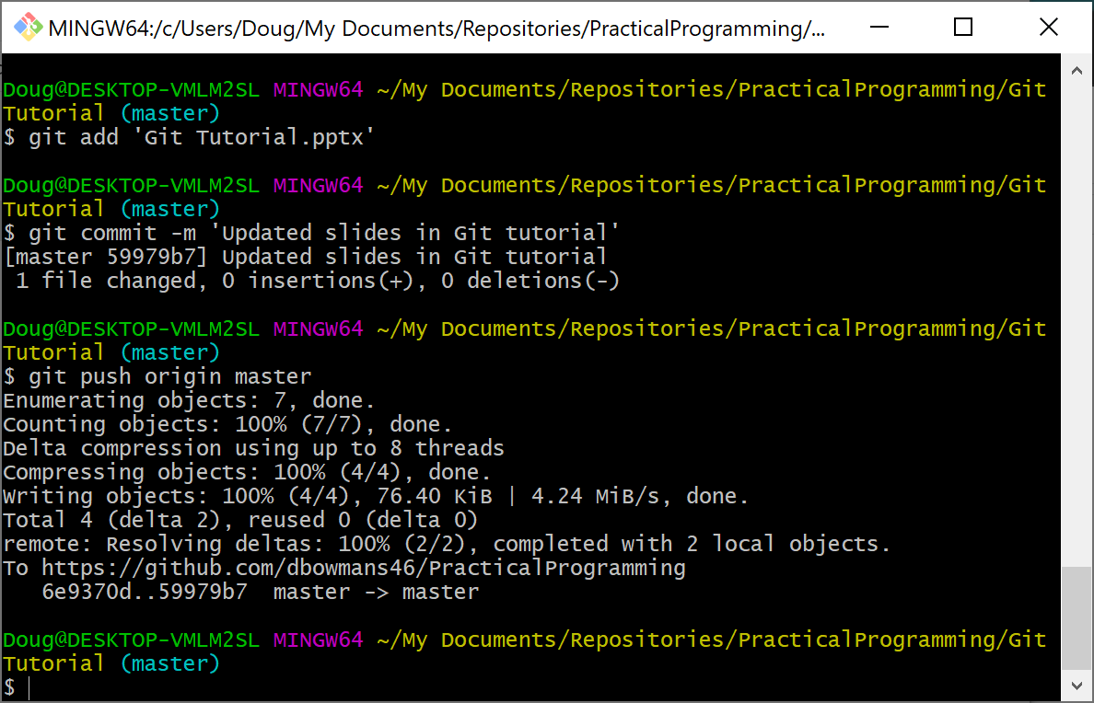
Updating the Master Branch
Merging Remote Branch

Slide 31
Useful Commands
Get files in a branch: ‘git ls-tree -r --name-only <name_of_branch>’

Slide 32
License
MIT License
Copyright (c) 2019 Doug Bowman dbowmans46@gmail.com
Permission is hereby granted, free of charge, to any person obtaining a copy of this software and associated documentation files (the "Software"), to deal in the Software without restriction, including without limitation the rights to use, copy, modify, merge, publish, distribute, sublicense, and/or sell copies of the Software, and to permit persons to whom the Software is furnished to do so, subject to the following conditions:
The above copyright notice and this permission notice shall be included in all copies or substantial portions of the Software.
THE SOFTWARE IS PROVIDED "AS IS", WITHOUT WARRANTY OF ANY KIND, EXPRESS OR IMPLIED, INCLUDING BUT NOT LIMITED TO THE WARRANTIES OF MERCHANTABILITY, FITNESS FOR A PARTICULAR PURPOSE AND NONINFRINGEMENT. IN NO EVENT SHALL THE AUTHORS OR COPYRIGHT HOLDERS BE LIABLE FOR ANY CLAIM, DAMAGES OR OTHER LIABILITY, WHETHER IN AN ACTION OF CONTRACT, TORT OR OTHERWISE, ARISING FROM, OUT OF OR IN CONNECTION WITH THE SOFTWARE OR THE USE OR OTHER DEALINGS IN THE SOFTWARE.

